Slide 2
Predicting APS failure at Scania truck
Team name : The Technocrats
Group members:
Md. Masudur Rahman (1631189042)
Saraf Sumaita Hasan (1631258042)
Md Rifat Hasan (1620259042)
Rehnuma Sharmin (1620739042)

Slide 3
Dataset explanation
Problem Discussion
Data preprocessing
Model Implementation
Result Analysis
Summary
Table of Contents

Slide 4
Dataset Explanation
Collected from the Industrial Challenge for IDA 2016
Collected from heavy Scania trucks in everyday usage.
Contains a training and test set
Consists of a subset of all available data, selected by experts
Attribute names have been anonymized for proprietary reasons
Consists of both single numerical counters and histograms consisting of bins with different conditions
Subset of all available data, selected by experts

Slide 5
Dataset Explanation
Characteristics : Multivariate
Attribute Characteristics: Integer, Real
Associated Task: Classification
Training dataset :
Number of Features : 171
Records : 60,000
Features : Anonymized
Type : Labeled
Testing dataset :
Number of Features : 171
Records : 16000
Features : Anonymized
Type : Labeled

Slide 6
Problem Discussion
The system in focus is the Air Pressure system (APS) which generates pressurized air that are utilized in various functions in a truck, such as braking and gear changes.
Classification problem (2 classes – Positive and Negative)
The positive class consists of component failures for a specific component of the APS system.
The negative class consists of trucks with failures for components not related to the APS.

Slide 7
Problem Discussion
Our main task is to find that the failure is APS related or not
And
Thus to find the misclassification and the penalty for having these misclassification and to minimize them
Failure –
Type 1 failure – False Positive (Penalty of 10)
Type 2 failure – False Negative (Penalty of 500)
Total cost = 10 * No of instances of Type 1 Failure + 500 * No of instances of Type 2 Failure

Slide 8
Challenges
High quantity of missing values
High imbalance in the class distribution

Slide 9
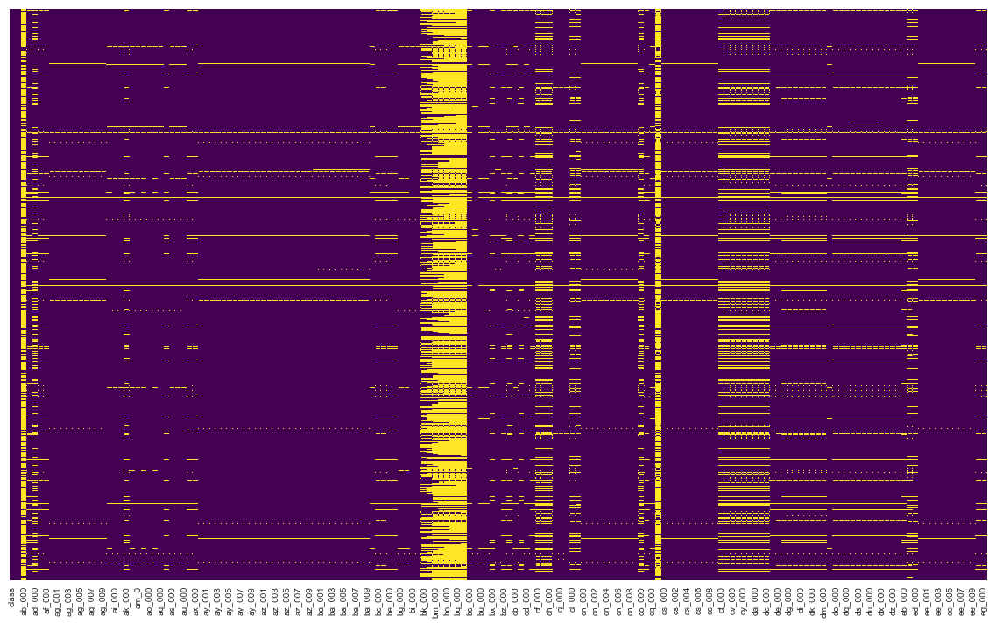
Data Preprocessing
Heatmap for Missing Values’ Representation
This graph representing missing values over the full dataset in yellow line

Slide 10
Data Preprocessing
For handling the missing values –
Discard the columns having more than 80% missing values
Replace all the missing values with their corresponding mean

Slide 11
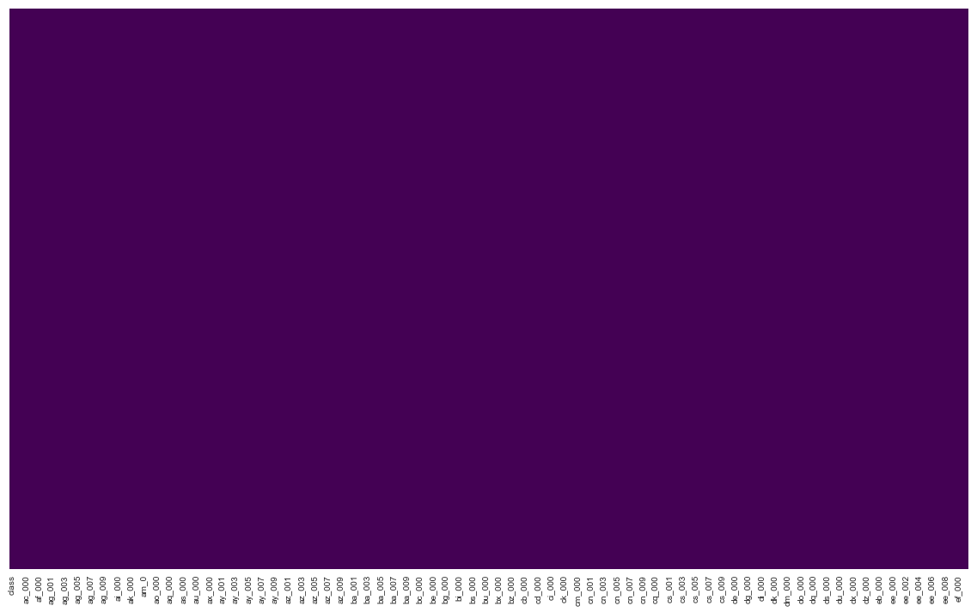
Data Preprocessing
After replacing all the missing values with their corresponding mean values ,
Heatmap for Missing Values’ Representation

Slide 12
Data Preprocessing
What will happen to the response class ?
Dummy variables ?
class | aa_000 | ab_000 | ac_000 | ad_000 | ae_000 | af_000 | ag_000 | ag_001 | ag_002
0 | 76698 | 0.713189 | 2.13E+09 | 280 | 0 | 0 | 0 | 0 | 0
0 | 33058 | 0.713189 | 0 | 190620.64 | 0 | 0 | 0 | 0 | 0
0 | 41040 | 0.713789 | 228 | 100 | 0 | 0 | 0 | 0 | 0
0 | 12 | 0.000000 | 70 | 66 | 0 | 10 | 0 | 0 | 0
0 | 60874 | 0.713189 | 1368 | 458 | 0 | 0 | 0 | 0 | 0
Sample data representation

Slide 13
Model Implementation
Dividing this section into 3 subsection –
Cross Validation
Threshold tuning
Predicting using the testing data

